Slide 1
Prime Server
Linda Zou

Slide 2
Overview
Design
Backend
Frontend
Exception Handling
Unit Test
Functional Test
CI-CircleCI
CI/CD – Jenkins/Amazon EC2
Source Code

Slide 3
Design
Concurrency: Reactive Programming
Backend: Spring WebFlux
Prime Integer: Java IntStream to Identify
Frontend: Thymeleaf
CSS: Bootstrap

Slide 4
Backend and Exception Handling
Repository: Business Logic
Controller: HTTP Request and Response
Exception: Mainly handle HTTP status 400 and 404

Slide 5
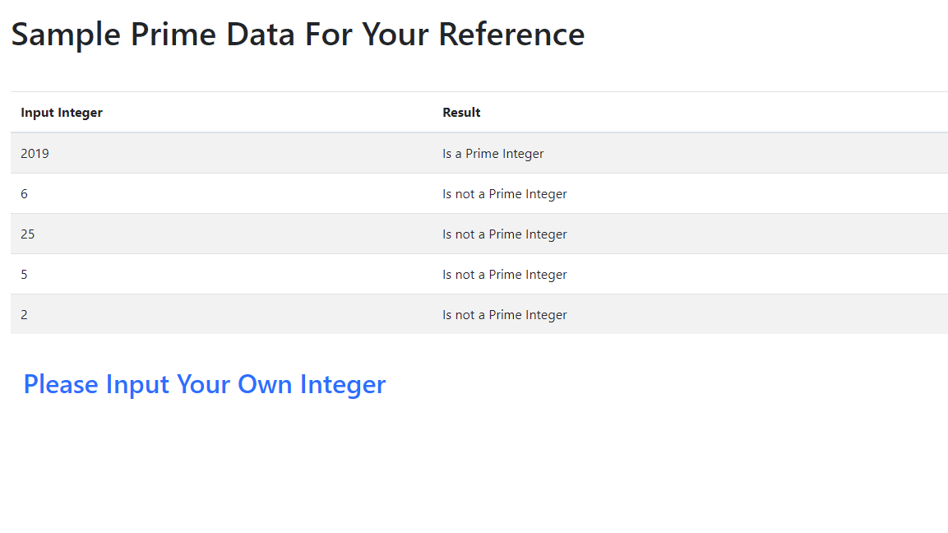
Frontend
Index.html: sample prime data for user reference

Slide 6
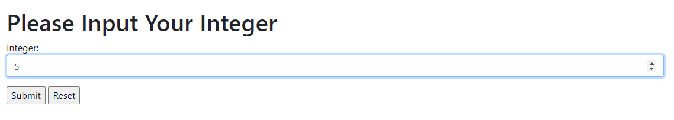
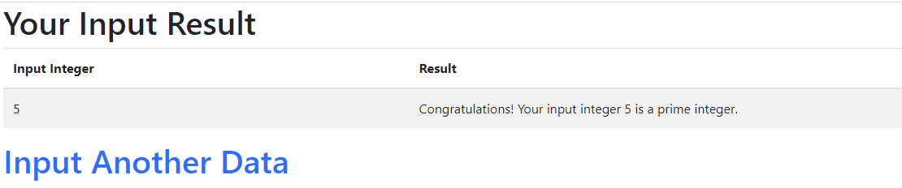
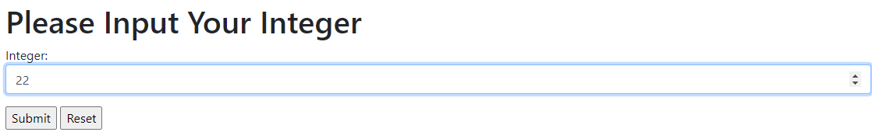
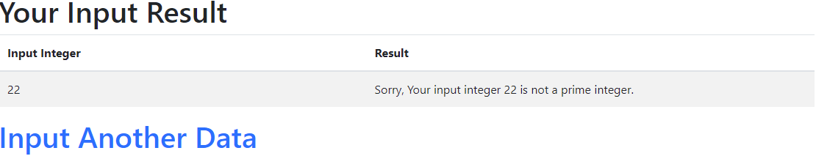
Request and Response

Slide 7
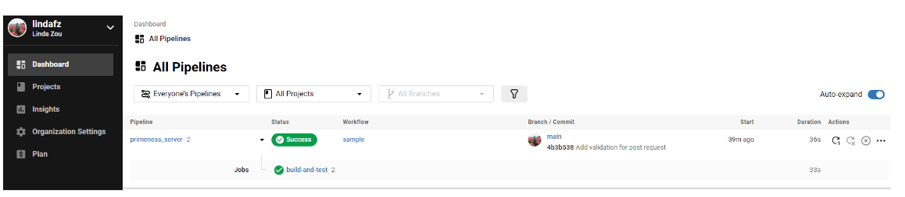
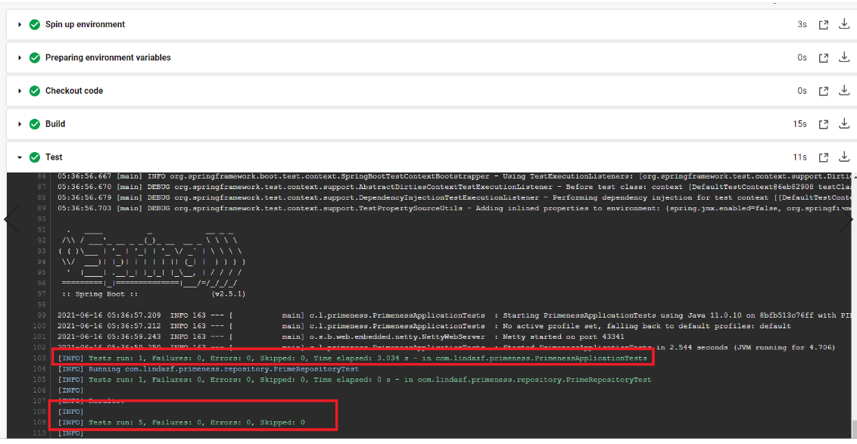
CI – CircleCI Build

Slide 8
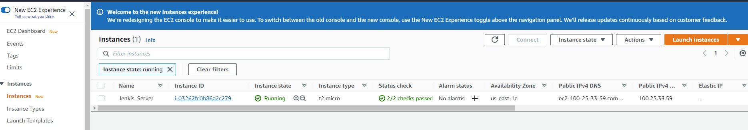
CI- Jenkins/EC2 Setup
Register AWS free account
Set up EC2, Jenkins Server, configure maven, github…

Slide 9
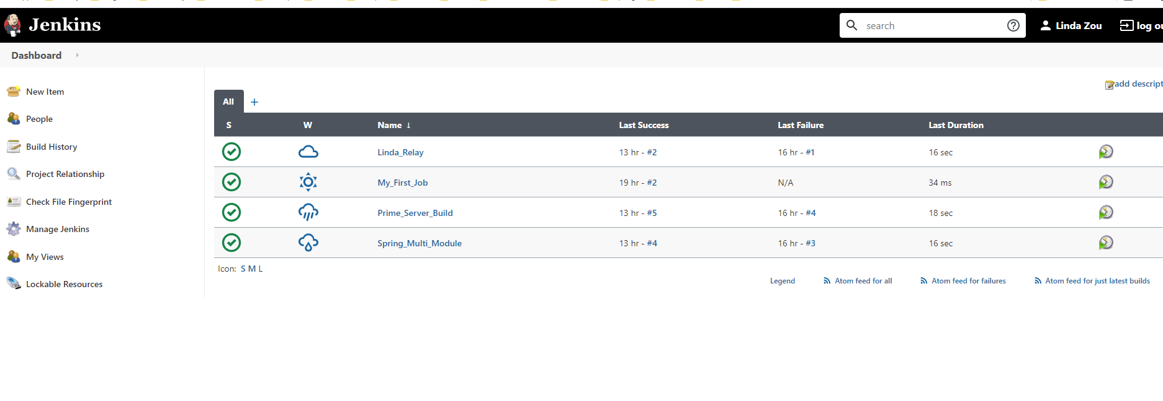
CI-Jenkins

Slide 10
CD- EC2/Jenkins/Docker
CD part set up is not finished and Dockerfile is not tested
Docker File: https://github.com/lindafz/primeness_server/Dockerfille

Slide 11
Source Code
Source code location: https://github.com/lindafz/primeness_server

